Slide 1





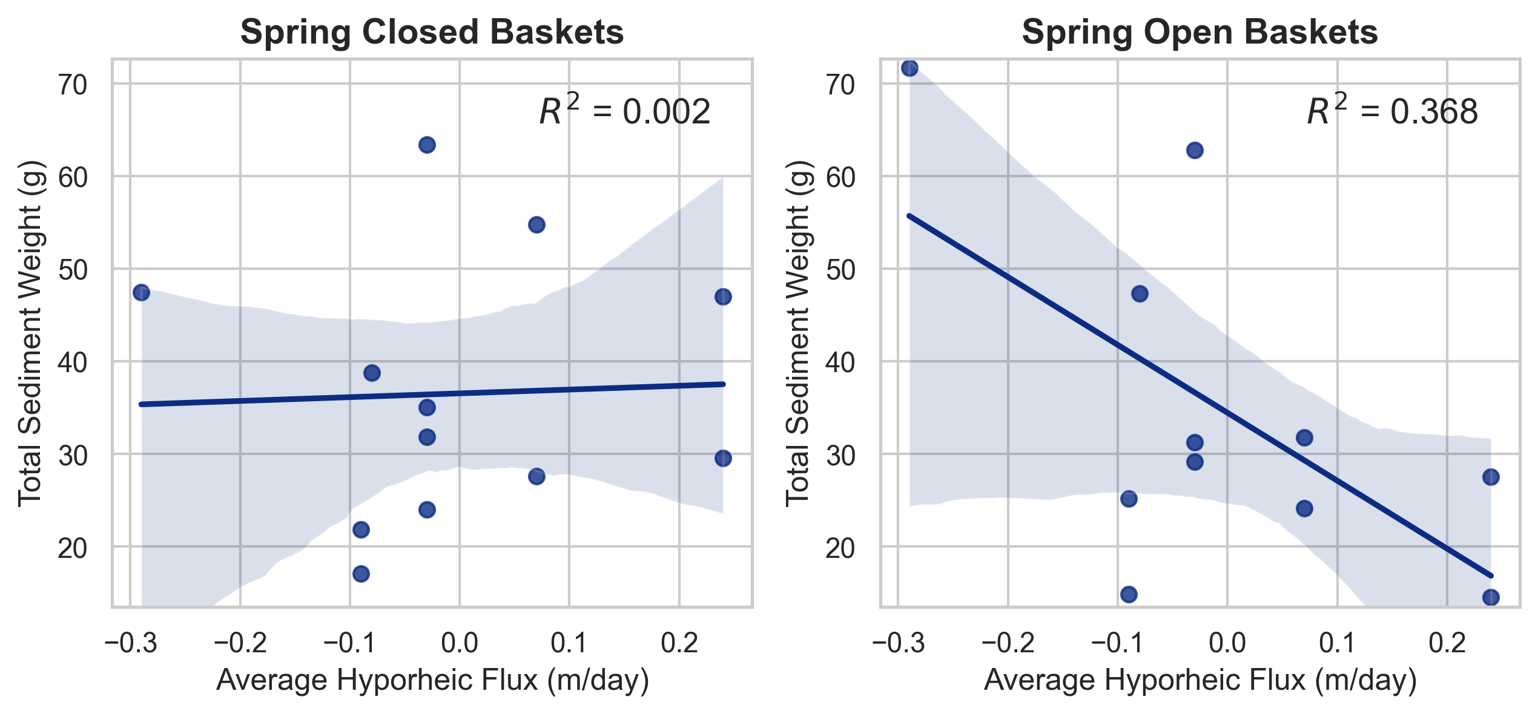
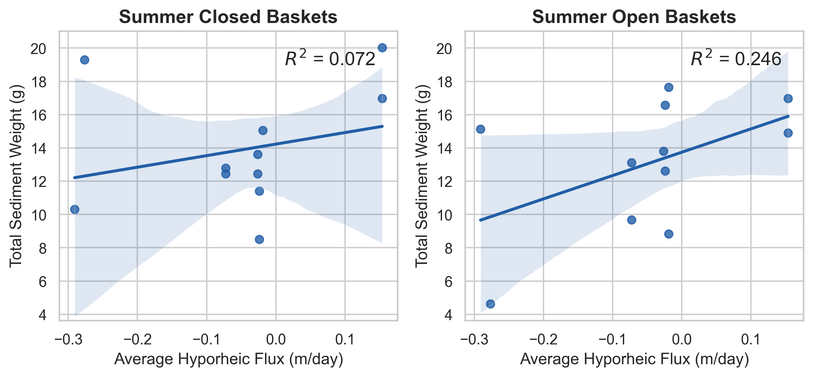
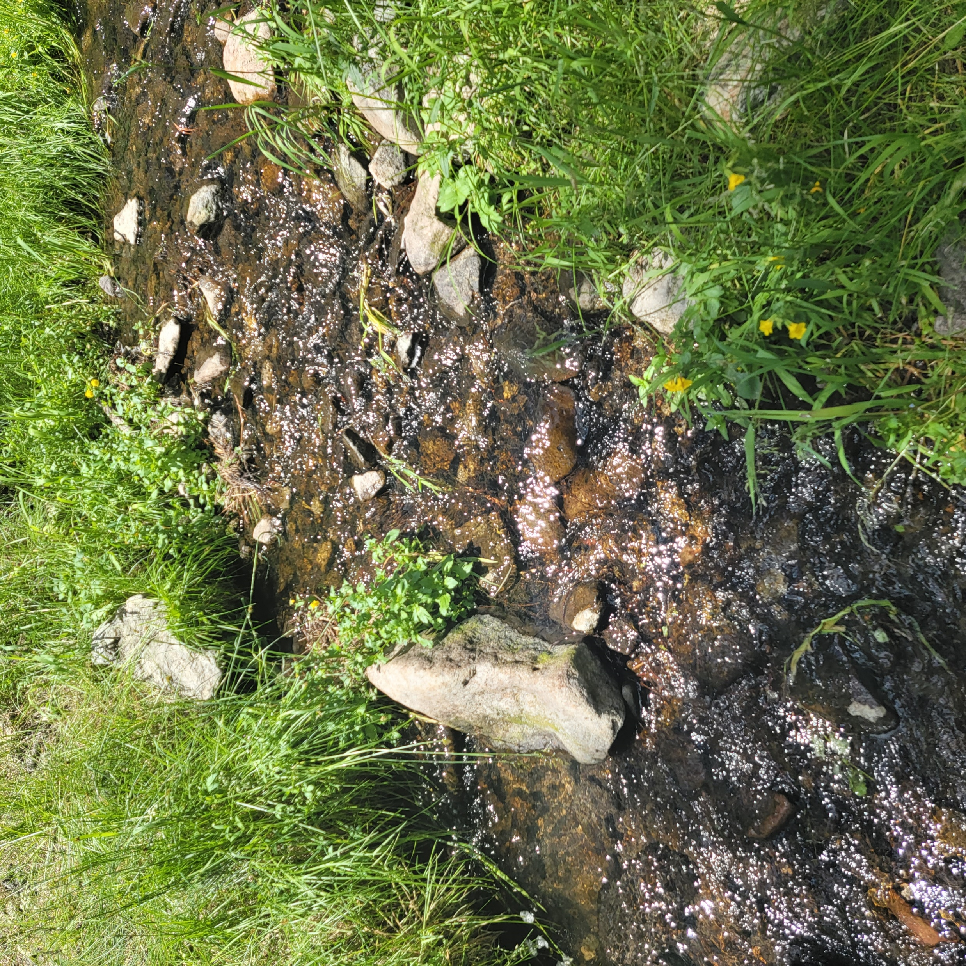
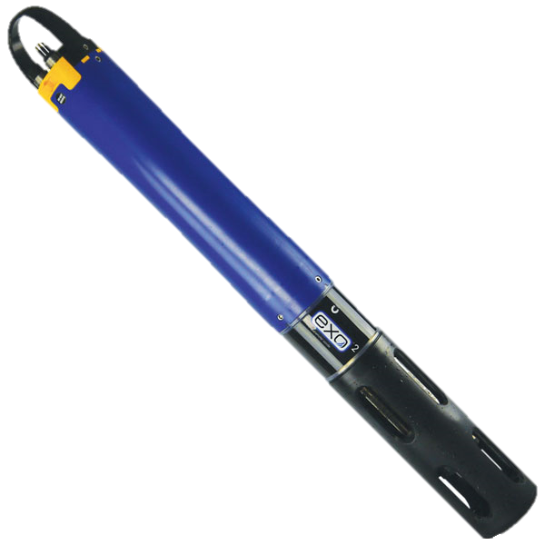
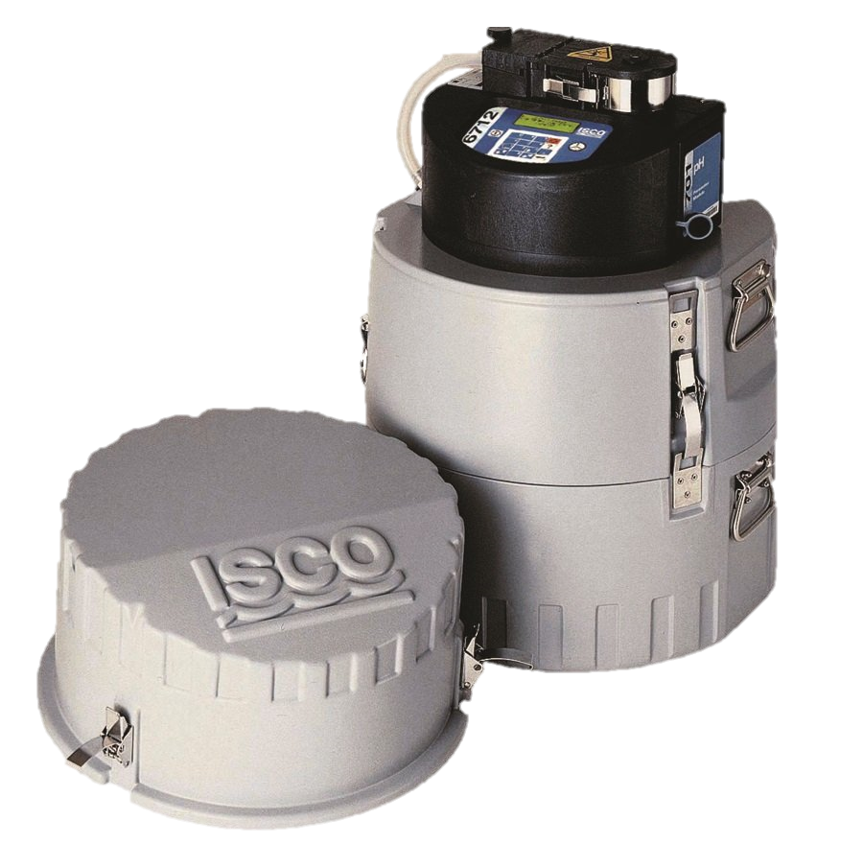
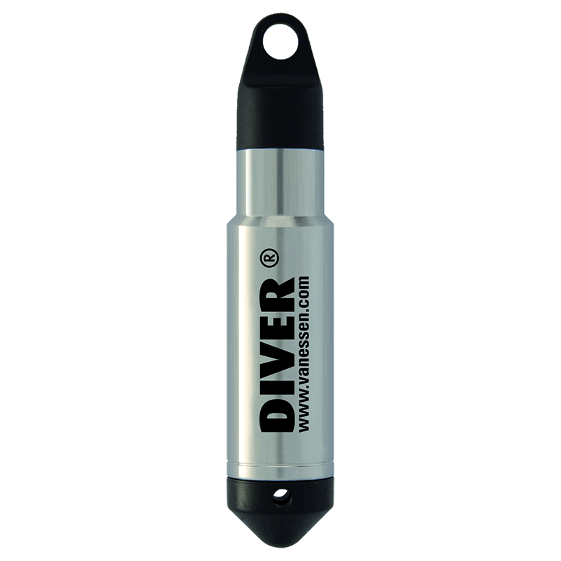
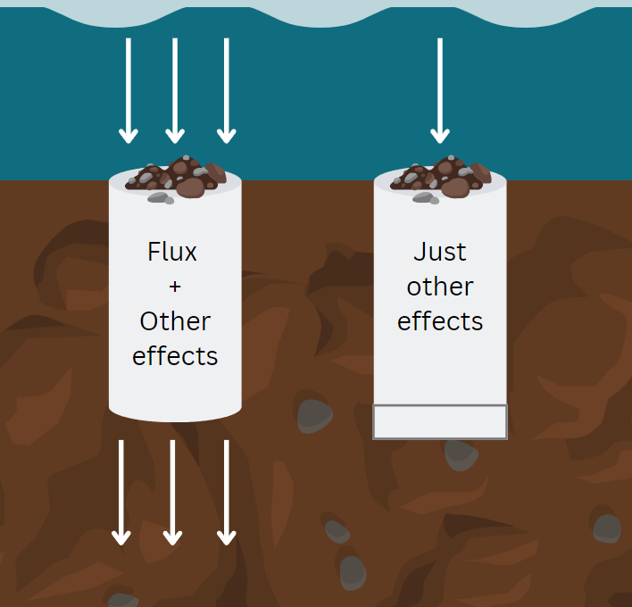
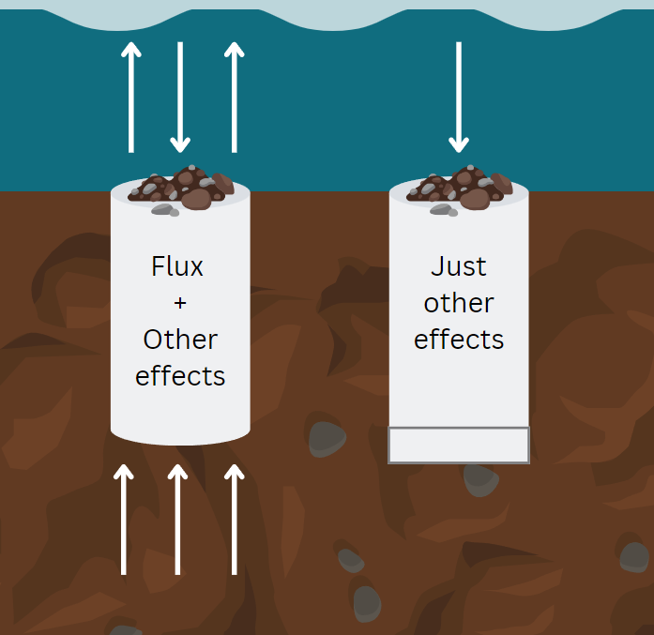
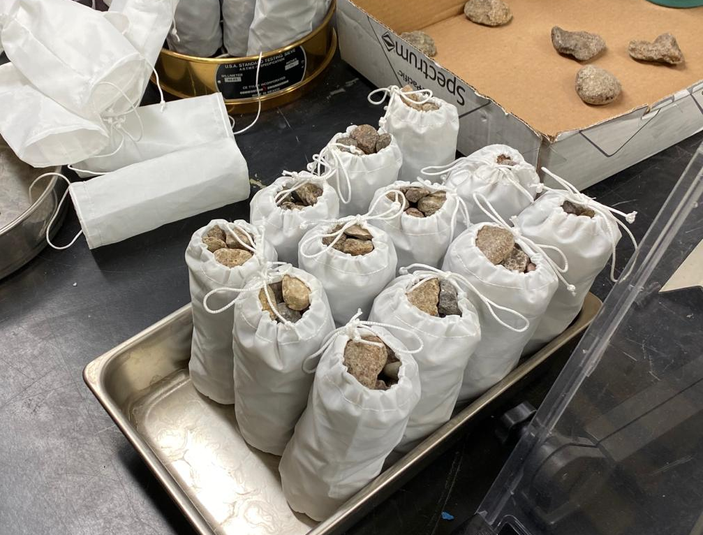
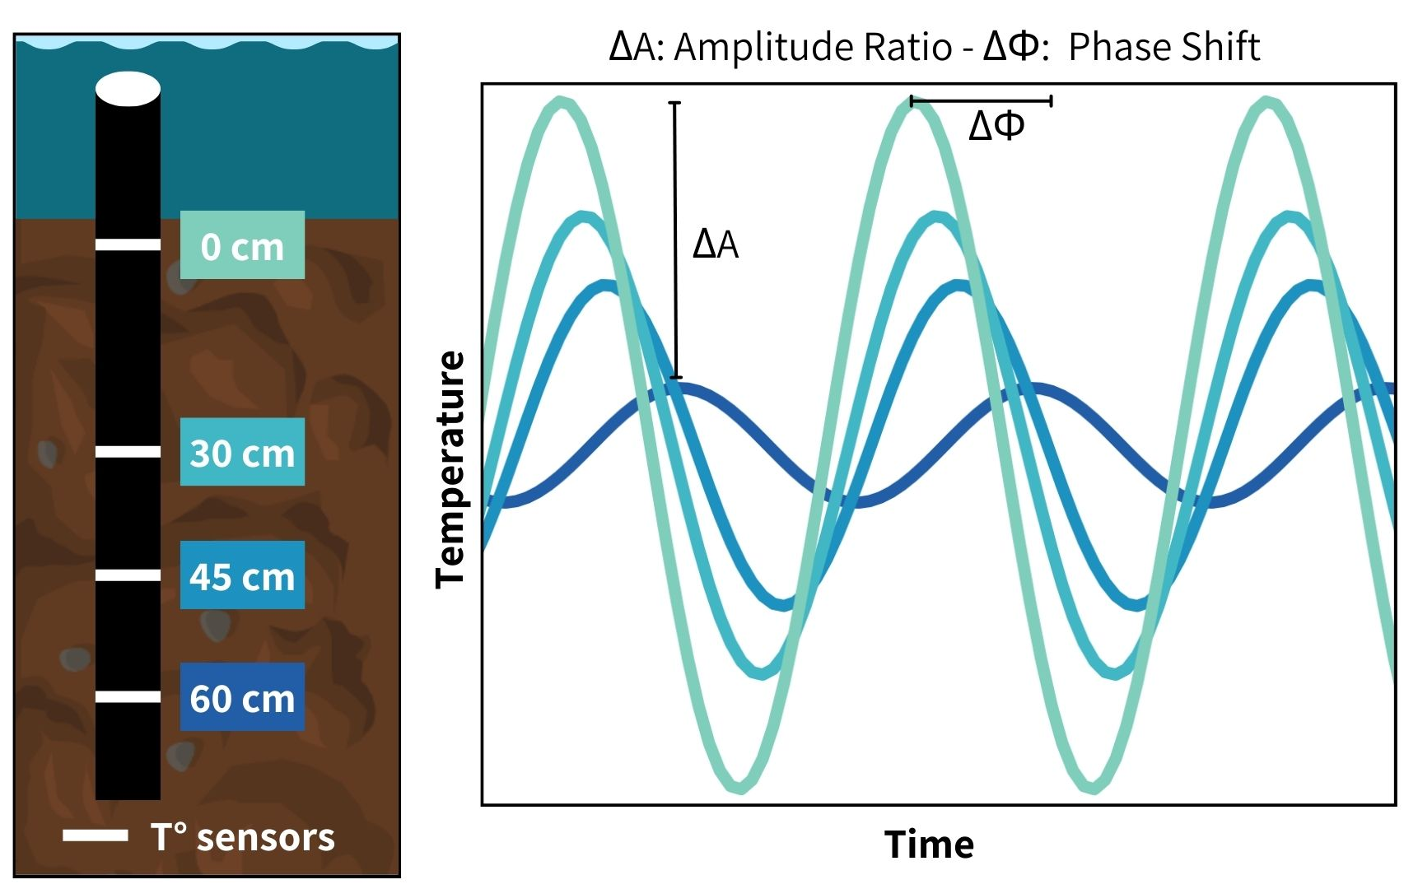
Impacts of streambed dynamics on nutrient and fine sediment transport in mountain rivers
Elowyn Yager^{1*}, Nicole Hucke¹, Rachel Watts², Andrew Tranmer¹, Janice Brahney², Joel Rowland³, George Perkins³ and Rose Harris³
¹University of Idaho, Boise, ID
²Utah State University, Logan, UT
³Los Alamos National Laboratory, Los Alamos, NM
Environmental System Science Program
Summary
Results: Spring vs Summer Fine Sediment Deposition
The armor layer protects the finer bed subsurface from erosion, but when dislodged during high flow events it can release fine sediment enriched in Phosphorus (P) and Organic Carbon (OC).
Hysteresis and seasonal variations in particulate and soluble reactive phosphorus (PP and SRP) and in particulate and dissolved organic carbon (POC and DOC) could be controlled by armor layer motion
By monitoring summer monsoon and snowmelt flows and conducting field experiments in a mountain stream in NM, our preliminary results suggest that the quantity of fine sediment in the riverbed is related to local hyporheic flux and near-bed flow velocity.
Particulate constituents such as POC, PP and suspended sediment (SS) often show clockwise hysteresis, whereas DOC tend to show counter-clockwise hysteresis, suggesting them coming from different sources.
We are currently investigating these sources and constraining the exact timing of armor layer motion in each event.
MORE SEDIMENT VOLUMES IN SPRING THAN IN SUMMER.
OPEN BASKETS BETTER CORRELATION BETWEEN FLUX AND DEPOSITED SEDIMENT THAN CLOSED BASKETS (trends are different in spring vs summer?)
Methods
Study Site: La Jara Creek,
Valles Caldera National Preserve, NM
1. Capturing Hysteresis:
Turbidity and fDOM*
Laboratory Procedures
Collected using a YSI EXO2 Sonde
SS – Laser diffraction
method (LISST portable XR)
POC – Eurovector elemental analyzer coupled to an Isoprime IRMS
DOC – OI Analytical Aurora 1030 TOC Analyzer
SRP & PP – SpectraMax M2e
Results: Seasonal Sediment and Carbon Hysteresis
Water samples (SS, SRP, PP, DOC & POC)
Stage-triggered portable ISCO samplers
Flow depth and Discharge
Particulates tend to have CW hysteresis and DISSOLVED CCW in summer
Particles still have CW in spring, but also CW for DOC
***** STILL NEED TO PLOT FDOM
Pressure transducers in stilling wells
* Fluorescent dissolved organic matter – a reliable proxy for DOC
2. Fine Sediment Deposition
Sediment traps with open and closed bottoms were installed next to subsurface temperature probes during the spring of 2023
Downwelling Conditions
Upwelling Conditions
Other deposition effects:
settling velocity
stream turbulence effects
3. Computing Hyporheic Flux
Temperature-monitoring probes were installed at the locations of the baskets. Through diel substrate water temperature fluctuations, we can solve the vertical flux from the 1D advection-diffusion equation.
Discussion and next steps
Results: Spring vs Summer Fine Sediment Deposition
Water column samples from spring and summer high flow events show that summer storms have higher sediment concentrations but smaller sizes, whereas spring showed lower concentrations and coarser PSD.
(show a plot with the D50 )
For questions, please contact huck4481@vandals.uidaho.edu or eyager@uidaho.edu

